Slide 1
OWN SOLAR POWER EVEN IF YOU RENT

Slide 2
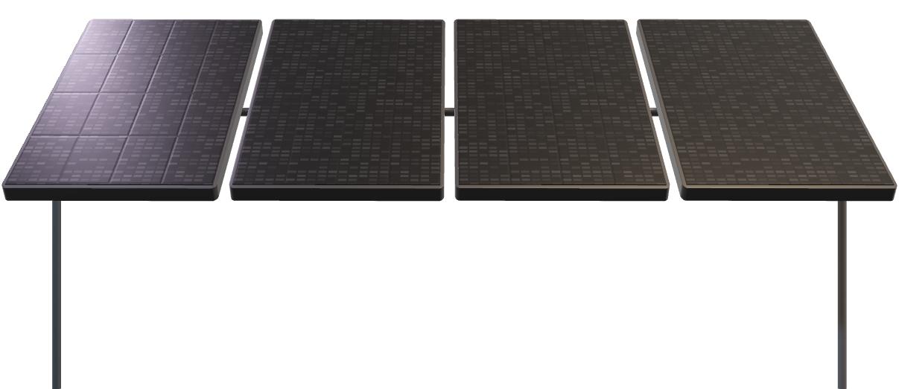
WE DON’T SELL SOLAR PANELS DESPITE THAT…

Slide 3

MILLIONS OF PEOPLE WANT SOLAR ENERGY AND CAN'T ACCESS IT:
RENTERS CAN'T INSTALL SOLAR PANELS
URBAN DWELLERS LACK ROOF SPACE
TRADITIONAL SOLAR IS COSTLY AND COMPLEX
CLIMATE-CONSCIOUS CONSUMERS FEEL POWERLESS

Slide 4
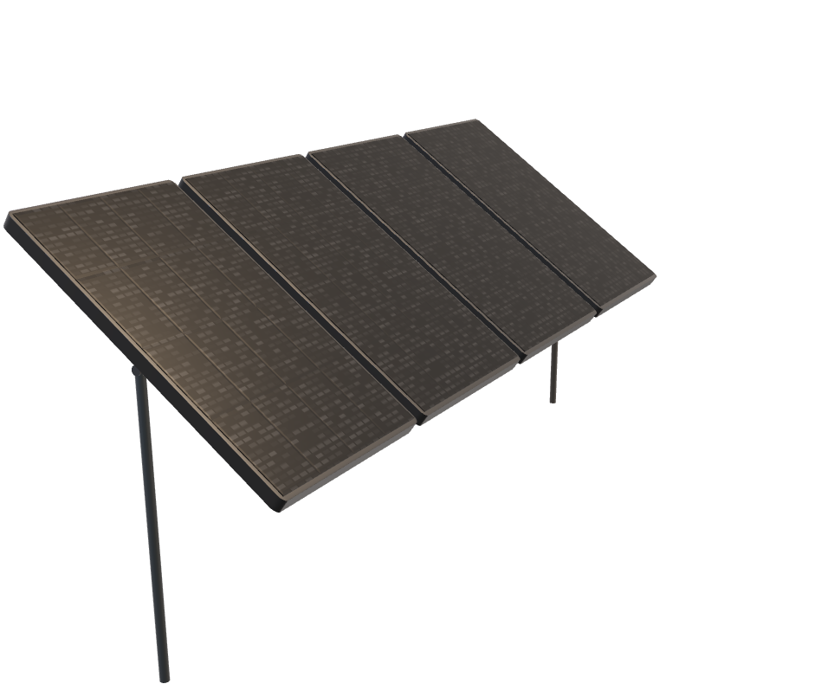
OPPORTUNITY
30%
70%
of all UK households are renting (including both private and social renters)
of EU households remain technically and economically untapped for solar installations
Sources: gov.uk | solarpower.org

Slide 5
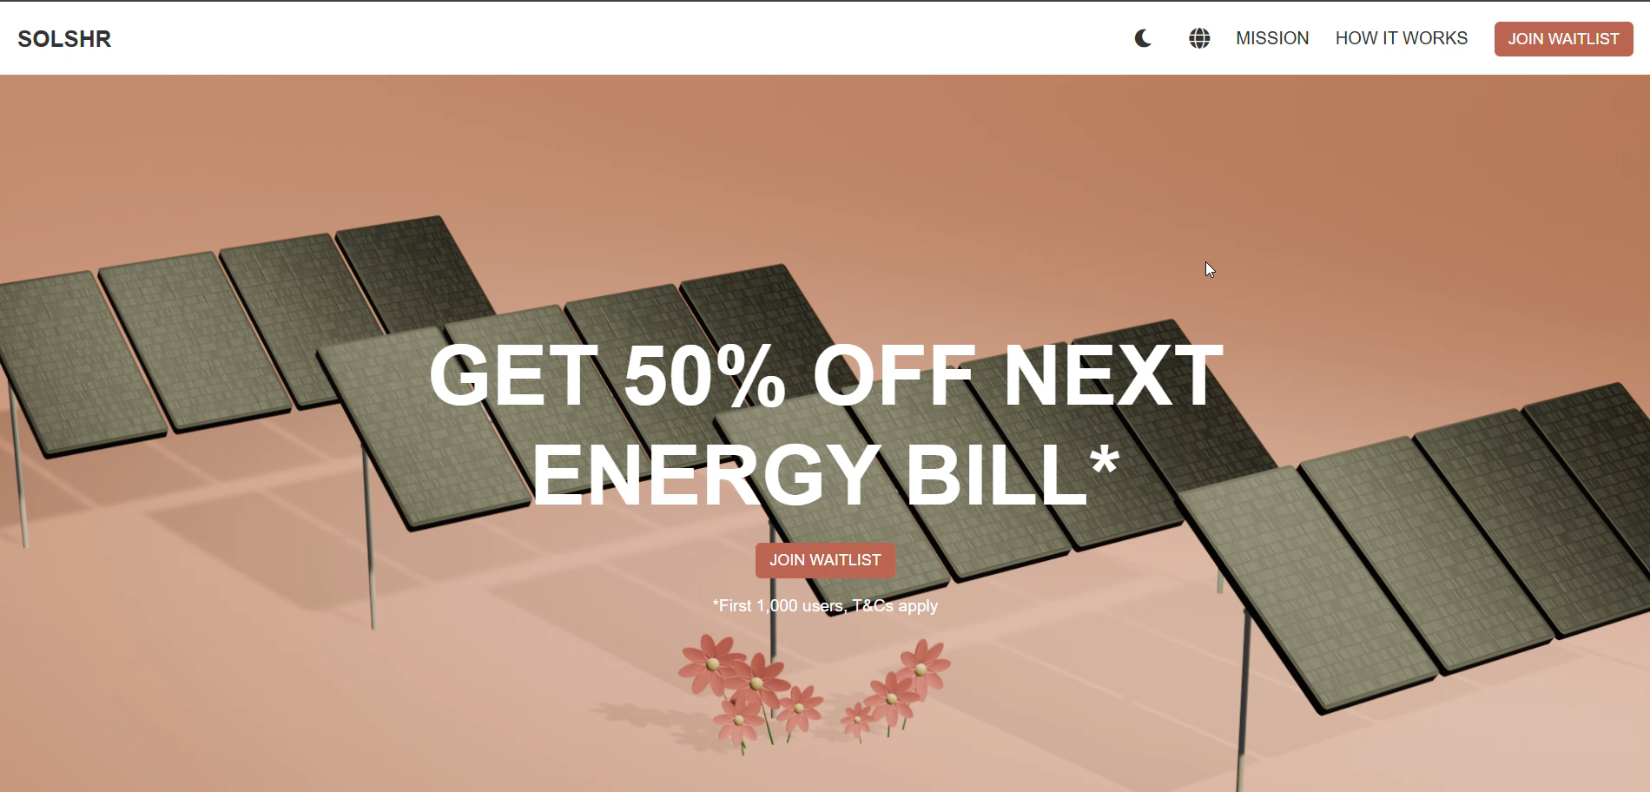
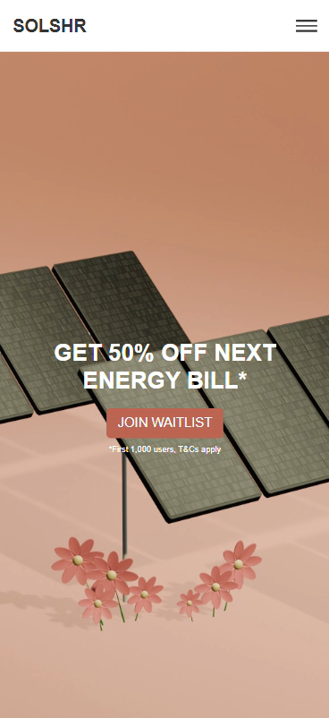
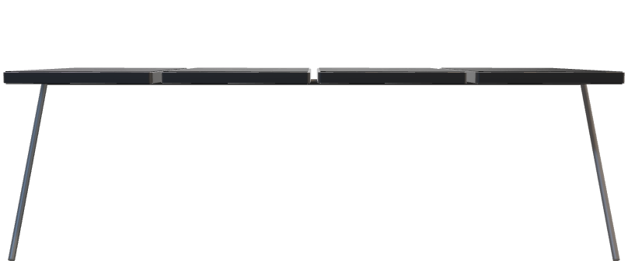
SOLSHR
IS A PLATFORM THAT LETS ANYONE CO-OWN COMMUNITY SOLAR FARMS AND EARN FROM THE POWER THEY GENERATE

Slide 6
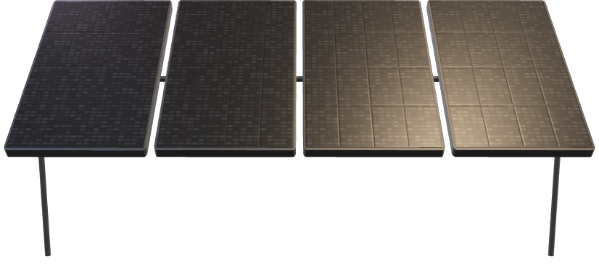
SOLSHR
LATIN FOR "SUN", REPRESENTING SOLAR ENERGY. EVOKES CLEAN, RENEWABLE POWER FROM THE SUN, CAN ALSO CARRY CONNOTATIONS OF LIGHT, WARMTH, AND SUSTAINABILITY
SHORT FOR "SHARE", EMPHASIZING: COMMUNITY OWNERSHIP, SHARED BENEFITS, COLLABORATIVE INVESTMENT

Slide 7
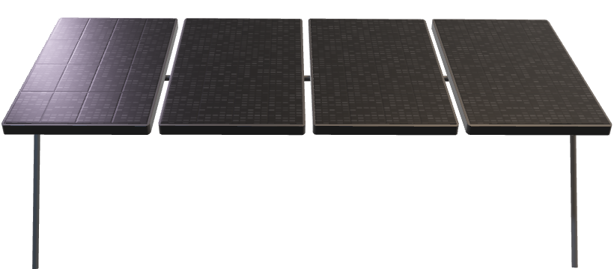
HOW IT WORKS
1
2
3
CHOOSE A SOLAR FARM PROJECT AND BUY OR RENT A SHARE OF IT
PANELS GENERATE SOLAR ENERGY, YOU EARN BASED ON PERCENTAGE OF YOUR SHARE
TRACK ENERGY GENERATED, EARNINGS AND ESTIMATED REDUCTION OF CO2 EMISSIONS IN REAL TIME

Slide 8
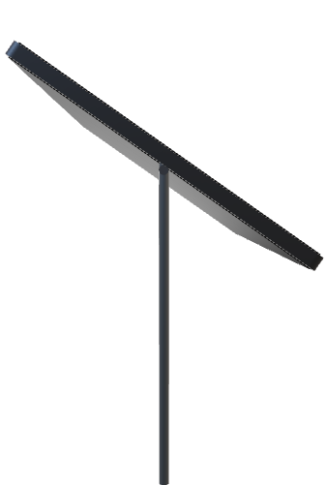
TARGET MARKET
UK
MD
LAUNCH MARKET
EASTERN EUROPE (EXPANSION)
AGES 25–45, MIDDLE CLASS AND ABOVE
RENTERS, YOUNG PROFESSIONALS, ECO-CONSCIOUS CONSUMERS
TECH-LITERATE, INTERESTED IN PASSIVE INCOME AND SUSTAINABILITY
Notes:
Urban areas with rising energy costs

Slide 9

BUSINESS MODEL
COMMISSION ON ENERGY CREDITS SOLD
SUBSCRIPTION PLANS FOR PANEL SHARES
ENERGY MARKETPLACE FOR COMMUNITY INVESTORS
API/DATA LICENSING FOR UTILITY PARTNERS
Notes:
Urban areas with rising energy costs

Slide 10
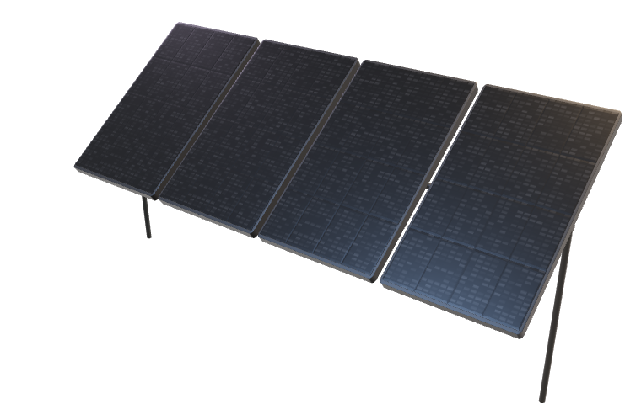
GO-TO-MARKET STRATEGY
SOCIAL- FIRST
INFLUENCER PARTNERSHIPS
TIKTOK, REELS, YOUTUBE SHORTS
GREEN TECH, FINANCE, REAL ESTATE
LOCAL PARTNERSHIPS
REFERRAL INCENTIVES
COUNCILS & ENERGY CO-OPS
FOR EARLY ADOPTERS
Notes:
Urban areas with rising energy costs

Slide 11
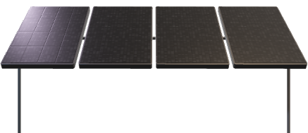
COMPETITIVE ADVANTAGE
AVERAGE COMPETITOR
✓
SUITABLE FOR RENTERS
⮾
✓
SIMPLE UX, FAST ONBOARDING
⮾
✓
TRANSPARENT EARNINGS DASHBOARD
⮾
✓
MEASURABLE CLIMATE IMPACT
⮾
Notes:
Urban areas with rising energy costs

Slide 12

TRACTION & ROADMAP
MVP LIVE SOLSHR.COM
WAITLIST GROWING VIA VIRAL CONTENT
LAUNCH UK PILOT (Q2 2026)
FINANCIAL INTEGRATIONS (Q4 2026)
●
●
●
VCs GOT INTERESTED
FIRST SOLAR FARM PARTNERSHIP TO BE SIGNED (Q4 2025)
EXPAND TO MOLDOVA (Q3 2026)
Notes:
Urban areas with rising energy costs

Slide 13
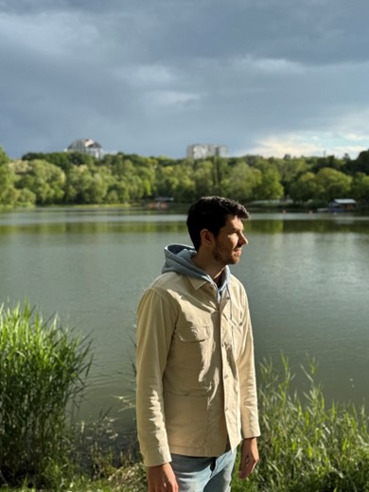
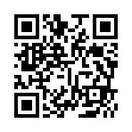



NOT RAISING MONEY YET
CONTACT: ALEX@SOLSHR.COM
ALEXANDR ABABII
FOUNDER
CONNECT ON LINKEDIN
MBA,
EXPERT MARKETER,
COMMUNITY BUILDER
SOCIALS:

